Slide 1

열정을 가진 자들이 모여 세상을 개척한다
심화반 Week 2.
Deep-Neural Network
Presenter: Daehyun Kim
GDG Campus Korea
MODULABS AI/SW Lab.

Slide 2
01
Deep-Neural Network

Slide 3
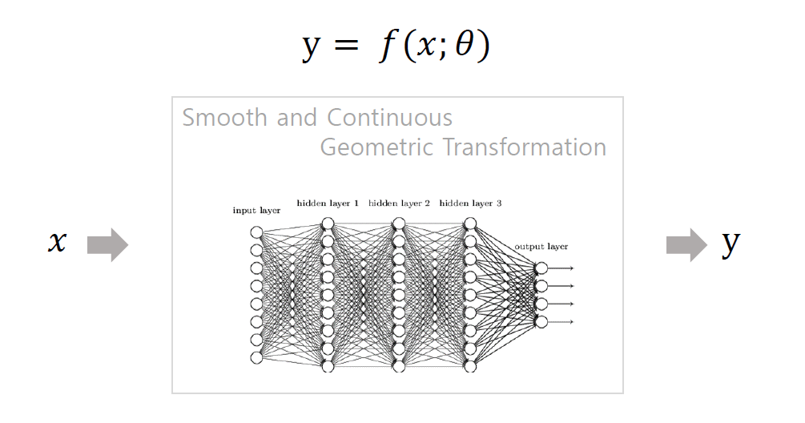
PNP
PASSSION & PIONEER
Deep-Neural
Network
Feedforward Network

Slide 4
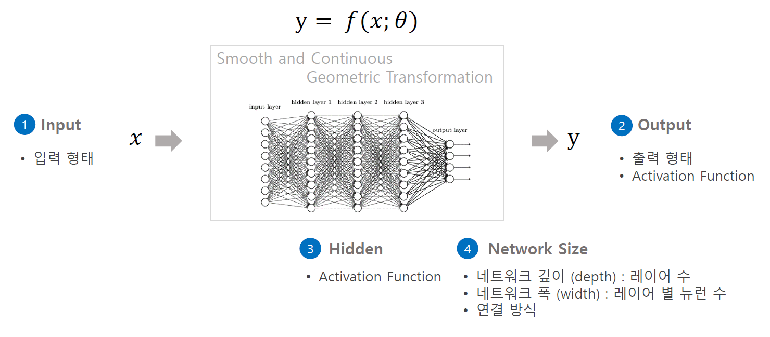
PNP
PASSSION & PIONEER
Deep-Neural
Network
Feedforward Network

Slide 5
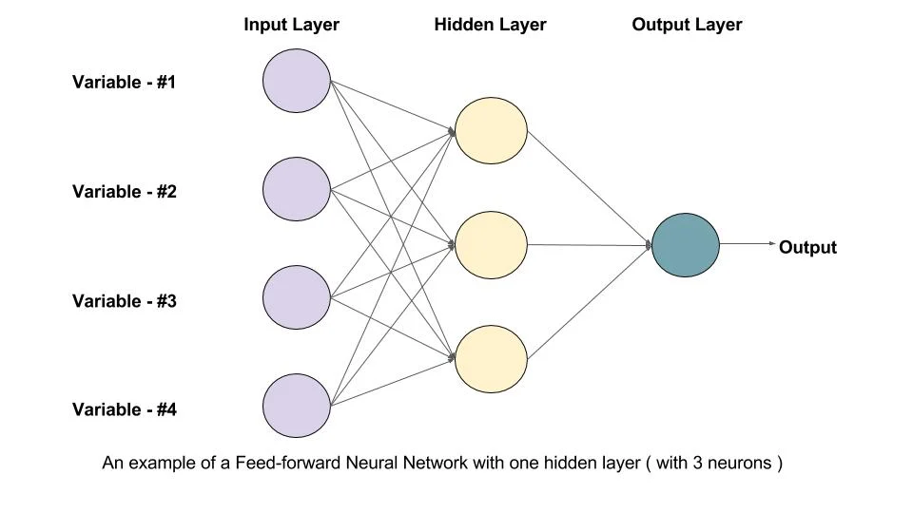
PNP
PASSSION & PIONEER
Deep-Neural
Network
Feedforward Network - input
Multi-layerd perceptron 과 같이 모든 노드가 연결된 네트워크
Fully-connected layer로도 불리며, 입력데이터를 1차원 형태의 벡터로 받아 처리한다.

Slide 6
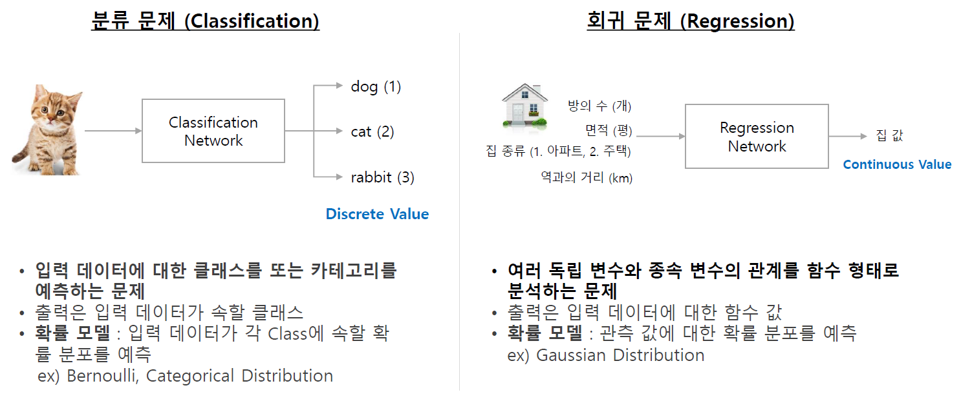
PNP
PASSSION & PIONEER
Deep-Neural
Network
Feedforward Network - Output

Slide 7
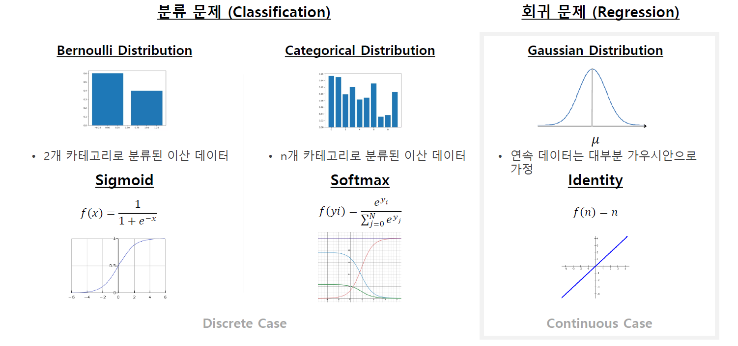
PNP
PASSSION & PIONEER
Deep-Neural
Network
Feedforward Network - Output

Slide 8
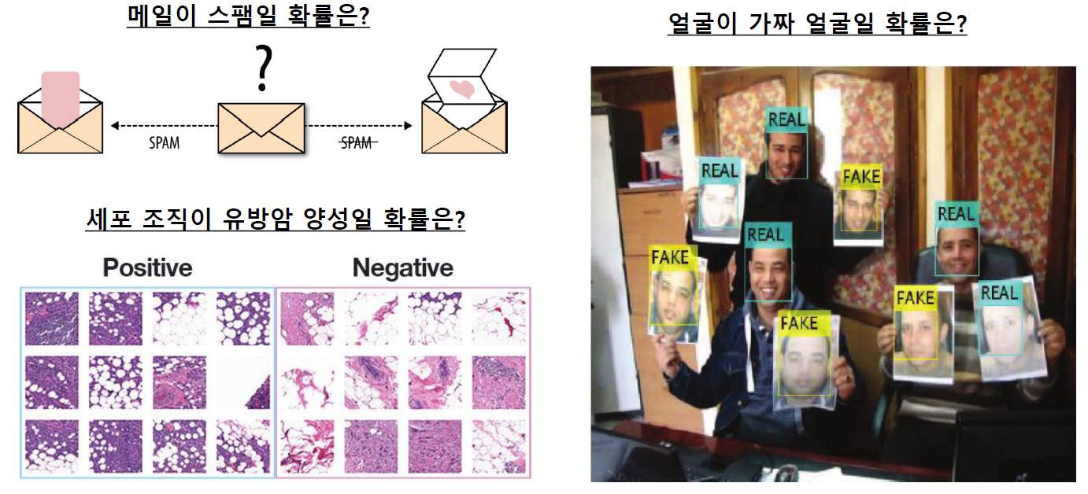
PNP
PASSSION & PIONEER
Deep-Neural
Network
Feedforward Network – Binary Classification (이진분류)

Slide 9
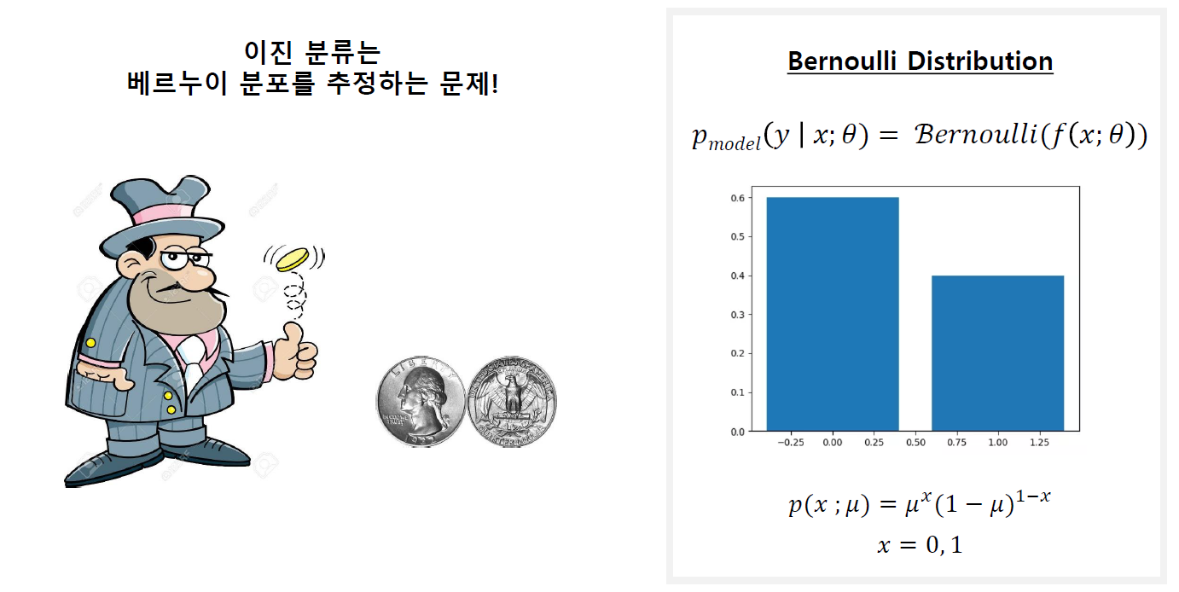
PNP
PASSSION & PIONEER
Deep-Neural
Network
Feedforward Network – Binary Classification (이진분류)

Slide 10
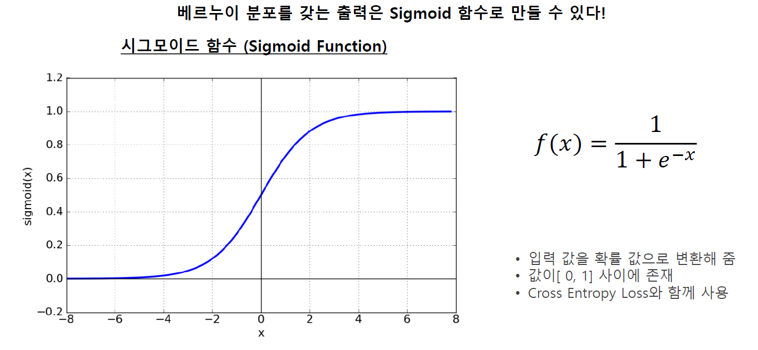
PNP
PASSSION & PIONEER
Deep-Neural
Network
Feedforward Network – Binary Classification (이진분류)

Slide 11
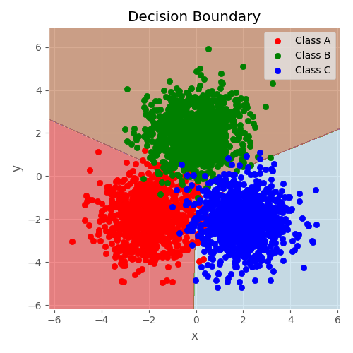
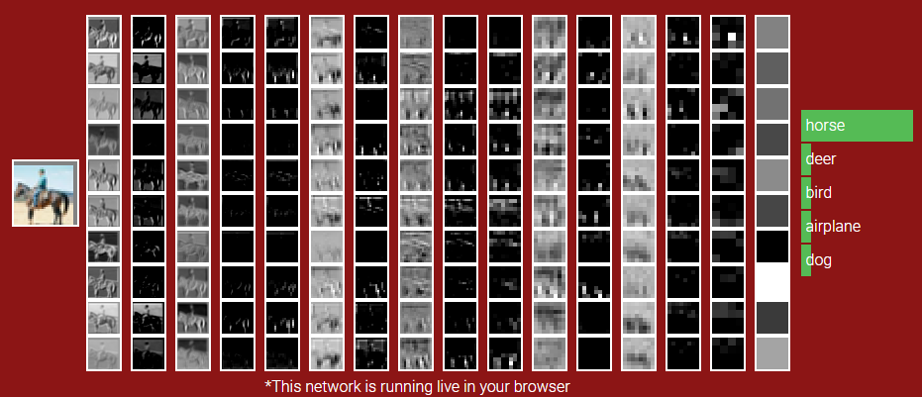
PNP
PASSSION & PIONEER
Deep-Neural
Network
Feedforward Network – 다중분류
데이터가 어떤 class에 속할 확률은?

Slide 12
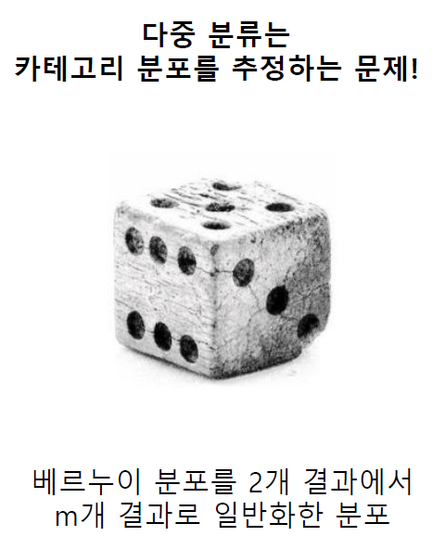
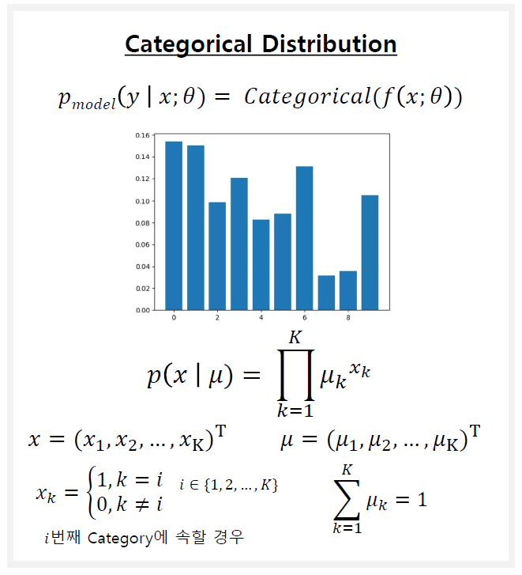
PNP
PASSSION & PIONEER
Deep-Neural
Network
Feedforward Network - 다중분류

Slide 13
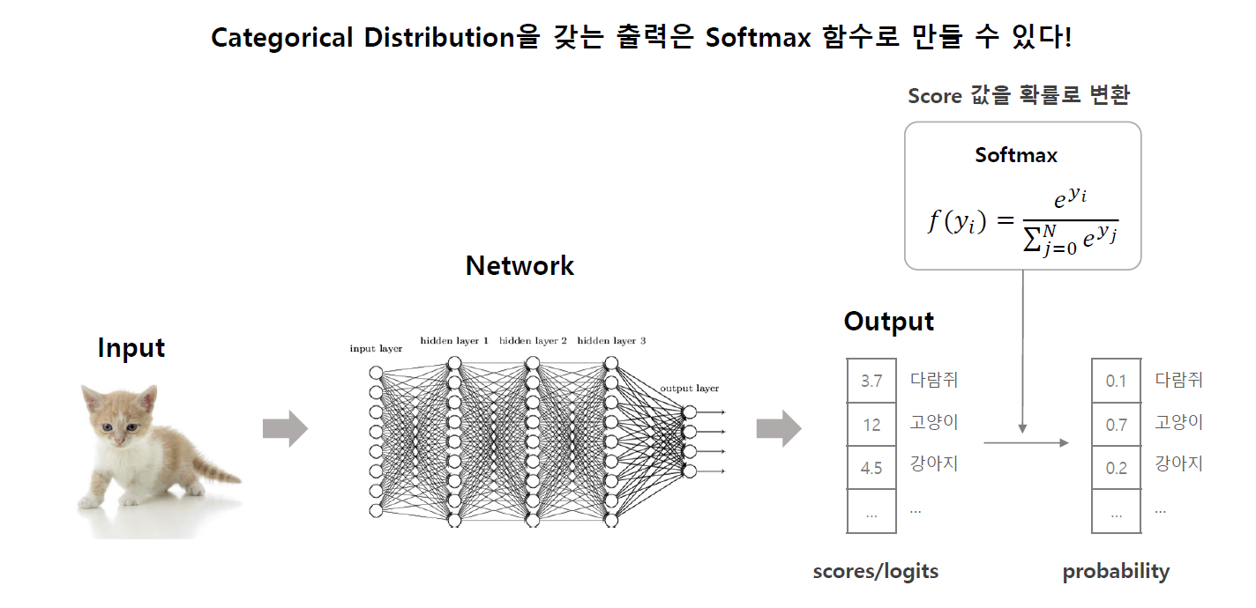
PNP
PASSSION & PIONEER
Deep-Neural
Network
Feedforward Network - 다중분류

Slide 14
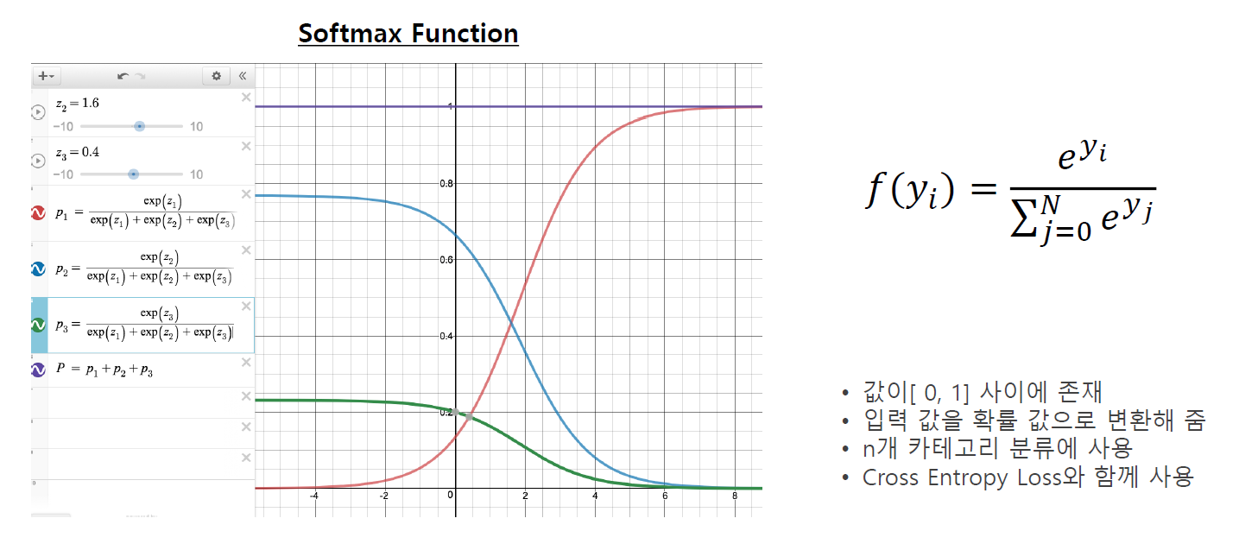
PNP
PASSSION & PIONEER
Deep-Neural
Network
Feedforward Network - 다중분류

Slide 15
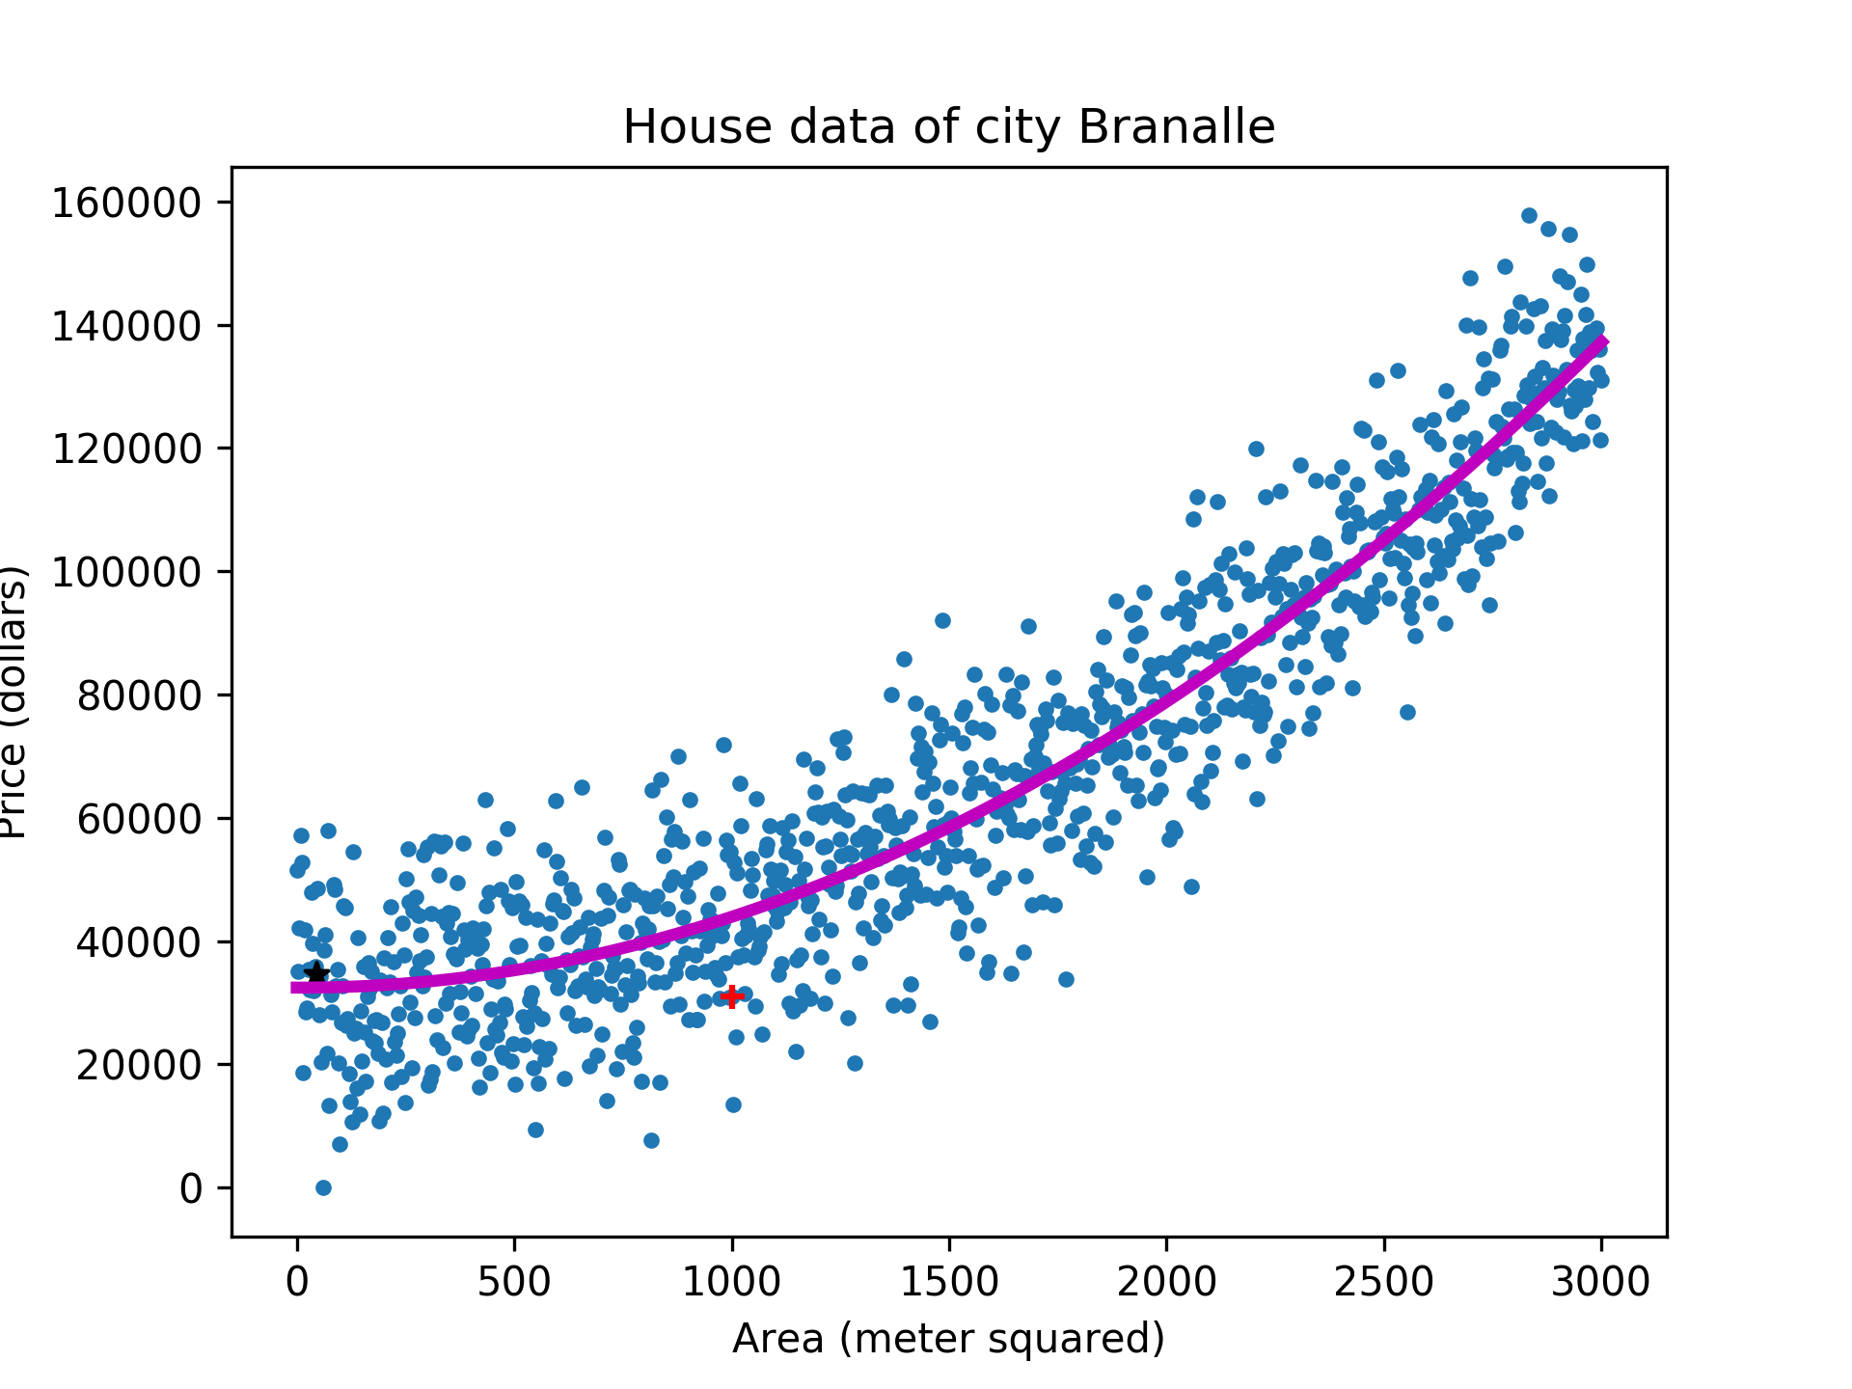
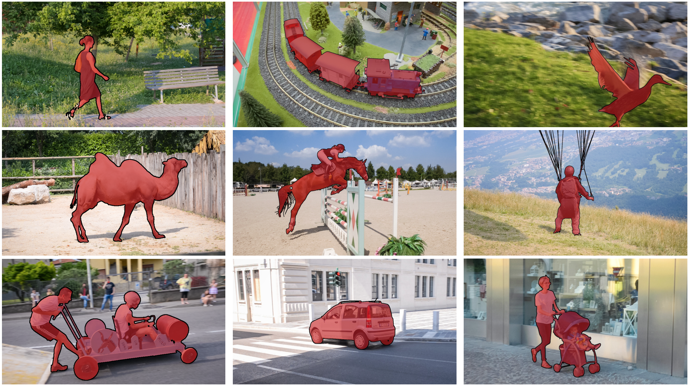
PNP
PASSSION & PIONEER
Deep-Neural
Network
Feedforward Network - 예측
입력 값에 대한 연속 함수의 값을 예측
Object segmentation

Slide 16
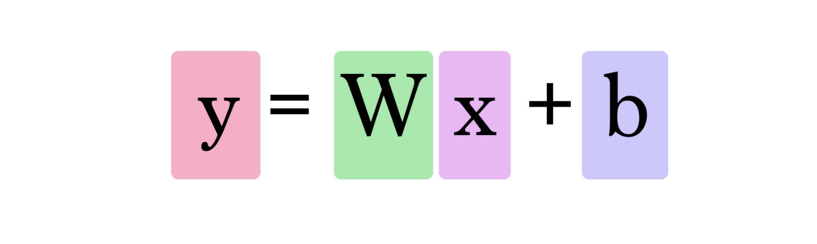
PNP
PASSSION & PIONEER
Deep-Neural
Network
Simple Feedforward Network
Model output
Our data
Our model

Slide 17
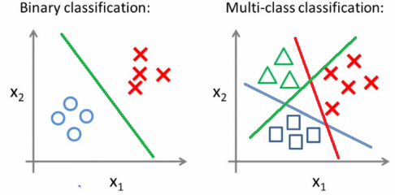
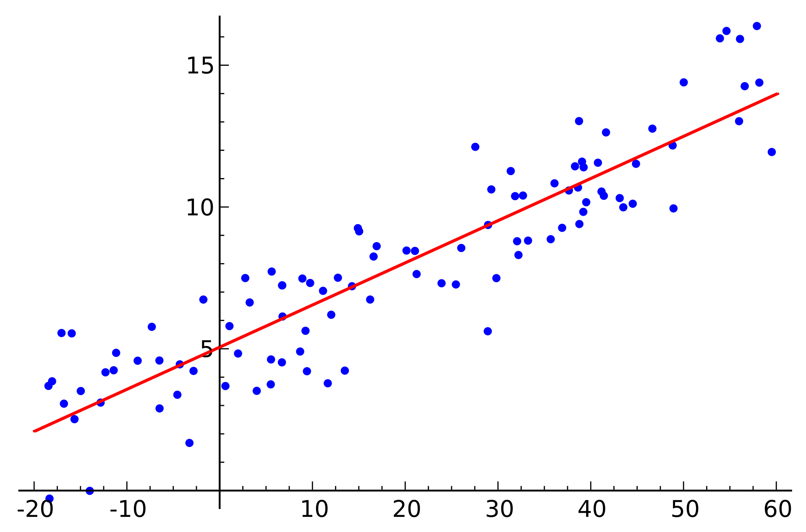
PNP
PASSSION & PIONEER
Deep-Neural
Network
Simple Feedforward Network
Linear regression
Binary classification
Multi-class classification

Slide 18
PNP
PASSSION & PIONEER
Deep-Neural
Network
Simple Feedforward Network
Hypothesis - 가설 설정 (모델 설정)
어떤 Hypothesis 가 좋을까? (어떤 모델이 좋을까?)
Loss(Cost) Function / Loss(Cost) 함수
Minimize Cost 비용 최소화

Slide 19
PNP
PASSSION & PIONEER
Deep-Neural
Network
Simple Feedforward Network
Our model
Our data x
Model output
https://en.wikipedia.org/wiki/Linear_regression

Slide 20
PNP
PASSSION & PIONEER
Deep-Neural
Network
Linear Regression
아래 데이터를 예측해보자
x | y
1 | 1
2 | 2
3 | 3
4 | 4
5 | 5

Slide 21
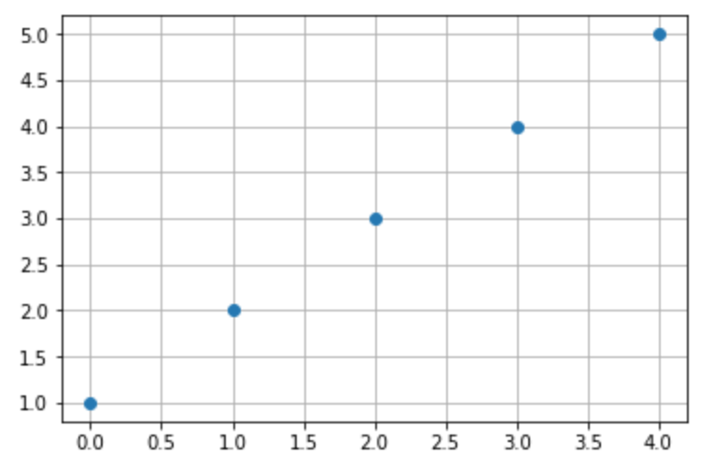
PNP
PASSSION & PIONEER
Deep-Neural
Network
Linear Regression
x | y
1 | 1
2 | 2
3 | 3
4 | 4
5 | 5
주어진 데이터를 그래프로 표현하면 아래와 같다.

Slide 22
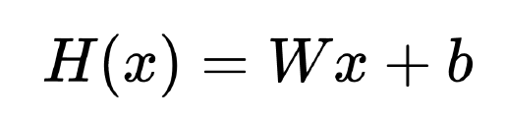
PNP
PASSSION & PIONEER
Deep-Neural
Network
Linear Regression -> Hypothesis (Linear)
주어진 데이터를 예측하는 직선을 가설로 설정
W, b 값에 따라서 다양한 가설이 설정 될 수 있다.

Slide 23
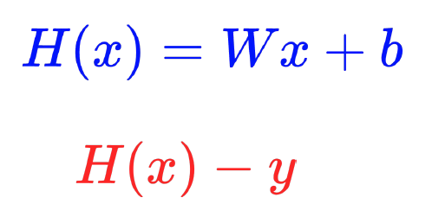
PNP
PASSSION & PIONEER
Deep-Neural
Network
Hypothesis -> Loss(Cost)
모델이 예측한 H(x) 값과 실제 데이터의 정답 y의 차이가 Loss가 된다.

Slide 24
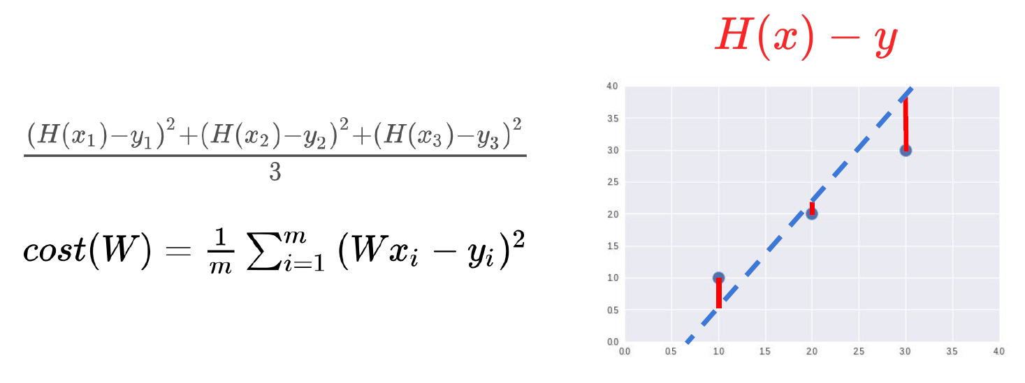
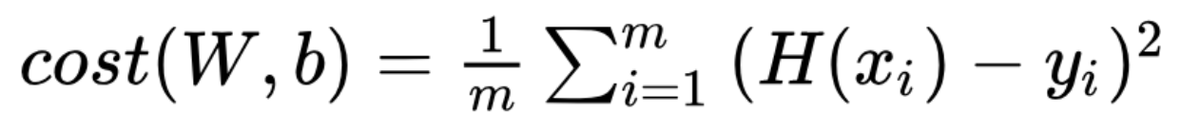
PNP
PASSSION & PIONEER
Deep-Neural
Network
Loss(Cost) function - Mean Squared Error
데이터가 3개일때 Loss를 구하면

Slide 25
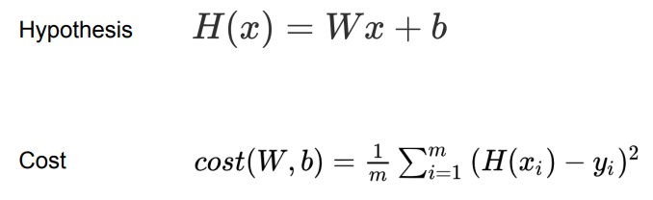
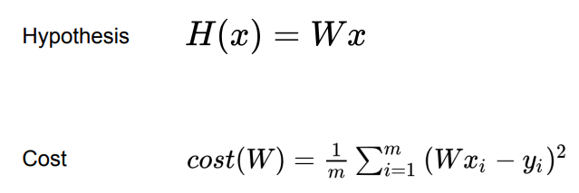
PNP
PASSSION & PIONEER
Deep-Neural
Network
Hypothesis and Loss(Cost)
최적화에 대한 그래프를 간단히 그리기 위해서 bias 제거

Slide 26
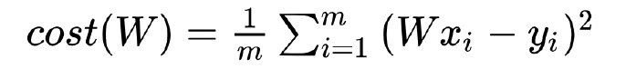
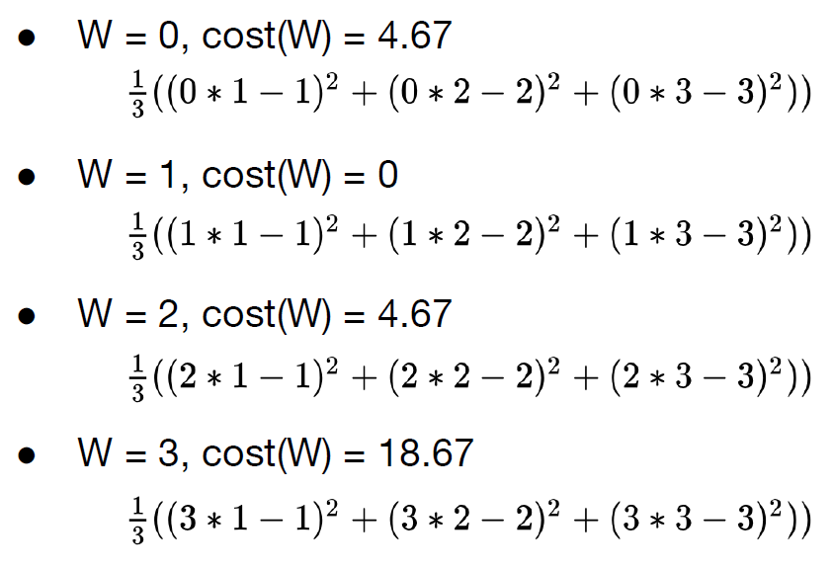
PNP
PASSSION & PIONEER
Deep-Neural
Network
Minimize Loss(cost)
예측을 위한 데이터 x와 Loss function을 이용해 loss를 구하자
x | y
1 | 1
2 | 2
3 | 3

Slide 27
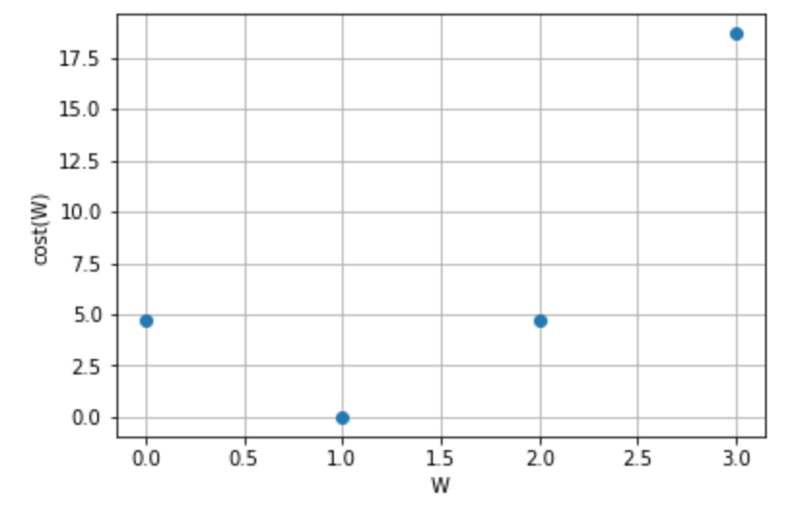
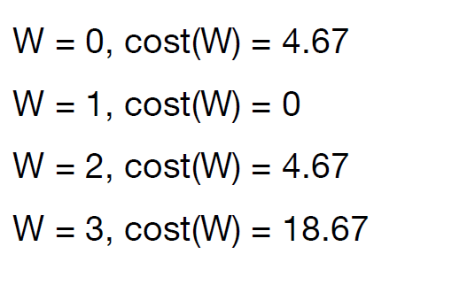
PNP
PASSSION & PIONEER
Deep-Neural
Network
Minimize Loss(cost)
계산된 Loss 값을 그래프로 그려보자

Slide 28
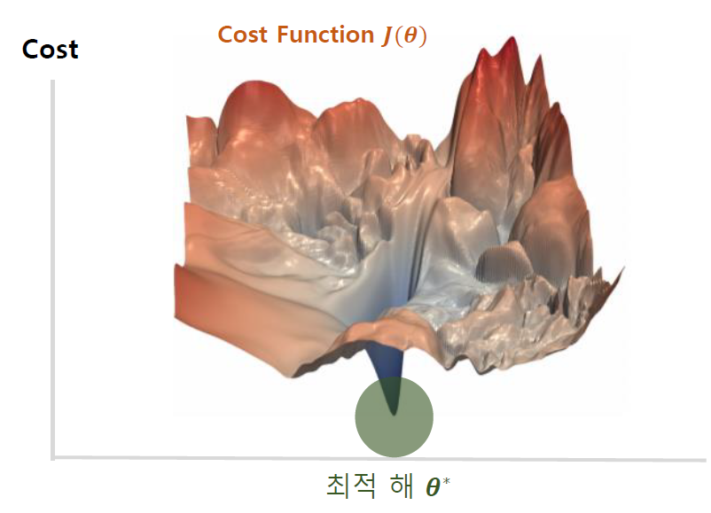
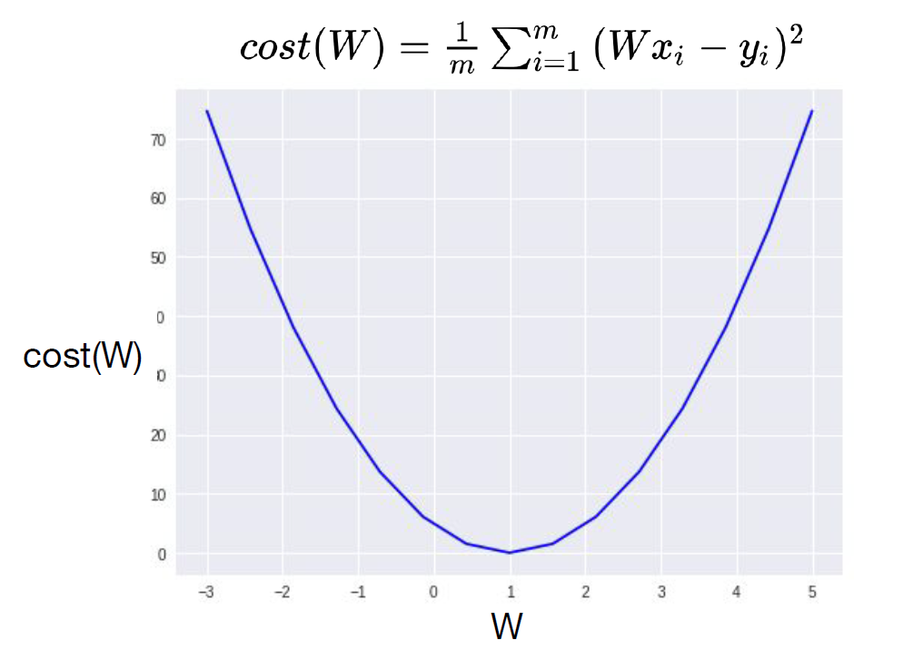
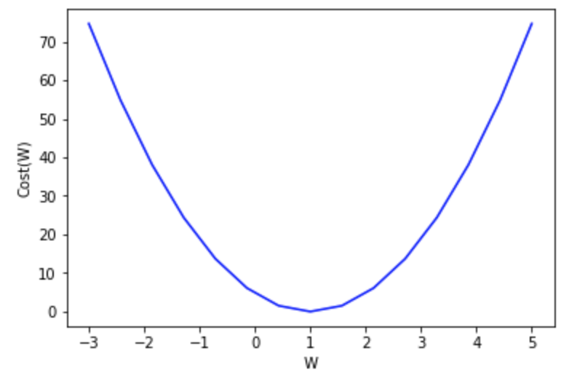
PNP
PASSSION & PIONEER
Deep-Neural
Network
Minimize Loss(cost)
조금 복잡한 모델 Loss Function 그래프
Cost Function을 아래와 같이 구할 수 있다.
w=1 일때
Loss 값이 최소
이 W를 어떻게 찾을 수 있을까?
우리가 찾는 W

Slide 29
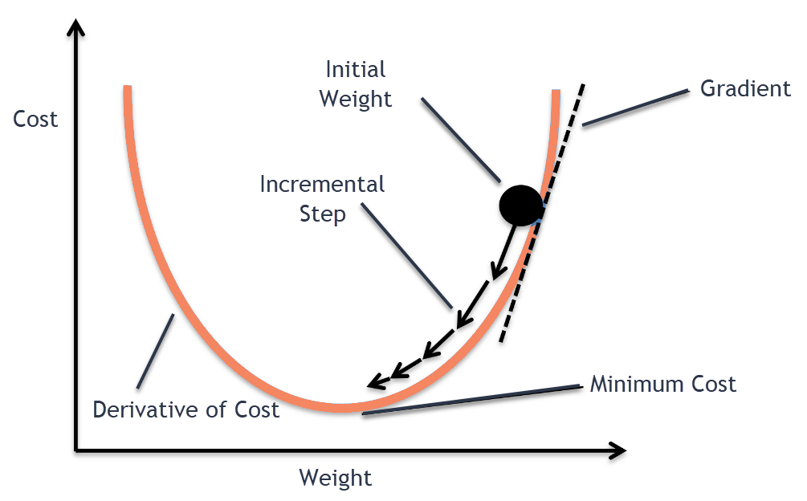
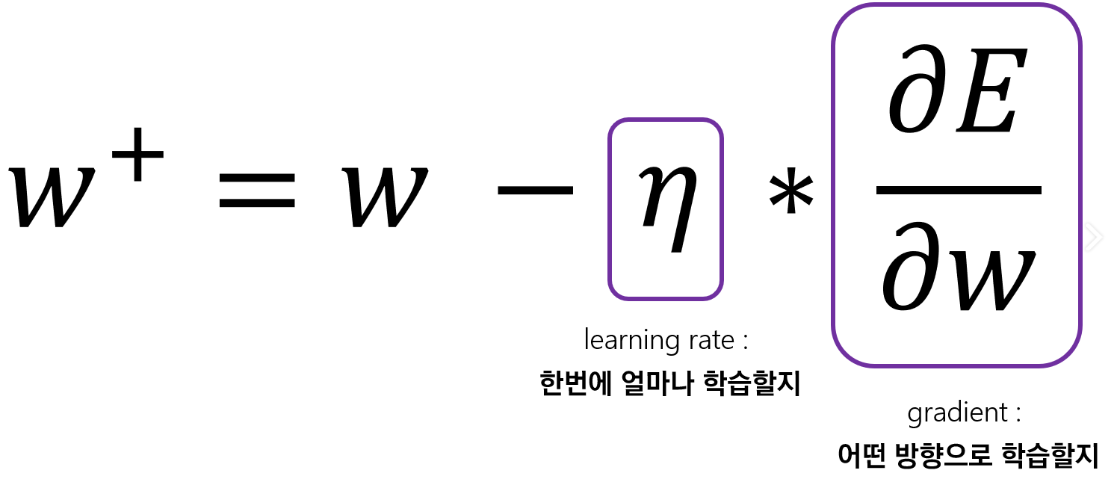
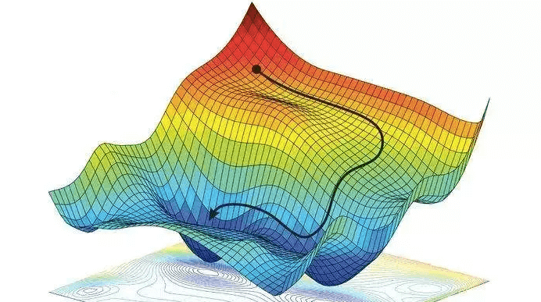
PNP
PASSSION & PIONEER
Deep-Neural
Network
Minimize Loss(cost)
https://medium.com/@divakar_239/stochastic-vs-batch-gradient-descent-8820568eada1

Slide 30
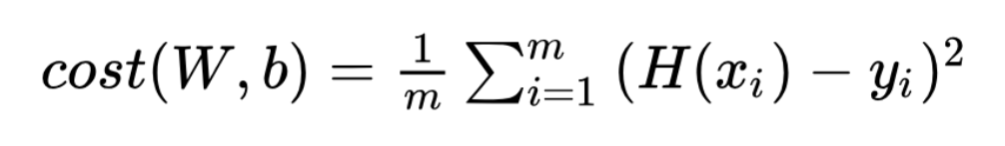
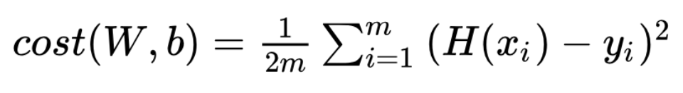
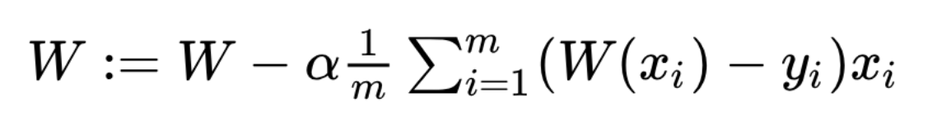
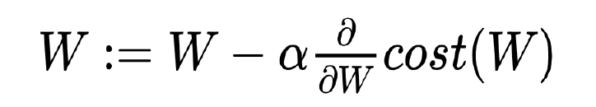
PNP
PASSSION & PIONEER
Deep-Neural
Network
Gradient descent algorithm
Gradient를 구하기 위해서 Loss function의 미분값을 구한다.
미분을 위해서 Normalize term * 1/2
미분된 값을 이용해 Weight를 업데이트한다.
alpha 값은 Learning rate

Slide 31
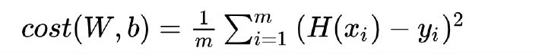
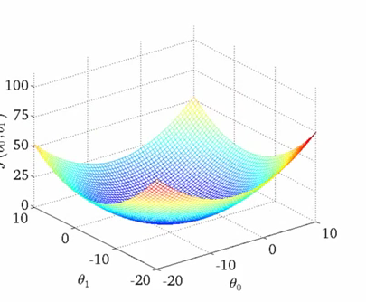
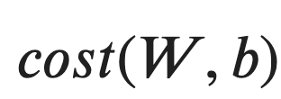

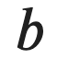
PNP
PASSSION & PIONEER
Deep-Neural
Network
Gradient descent algorithm
위 방법을 이용해 최적의 W 값을 찾을 수 있다.
https://blog.paperspace.com/intro-to-optimization-in-deep-learning-gradient-descent/

Slide 32
PNP
PASSSION & PIONEER
Deep-Neural
Network
Multi-variable Linear regression
주어진 데이터가 Multi-variable인 경우의 regression을 알아보자
X1 | X2 | X3 | Y
96 | 91 | 99 | 194
88 | 85 | 82 | 181
78 | 77 | 73 | 177
67 | 66 | 61 | 164
55 | 51 | 53 | 157

Slide 33
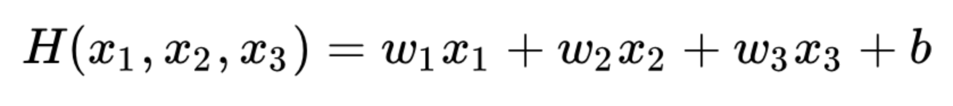
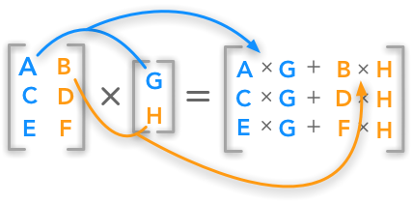
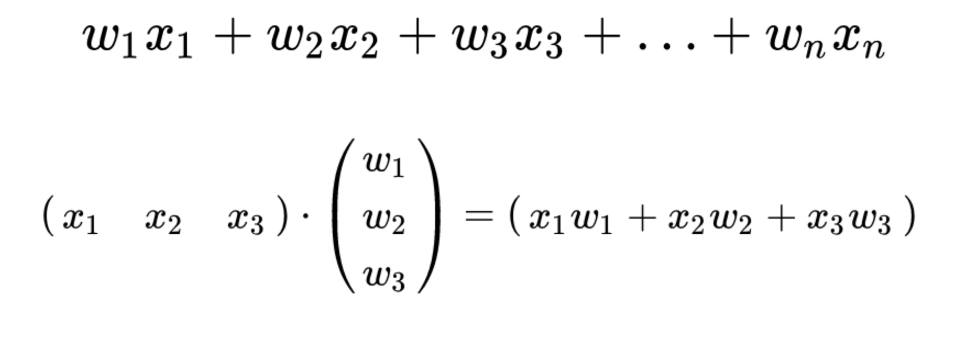
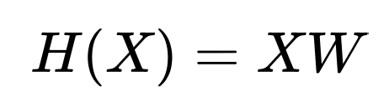
PNP
PASSSION & PIONEER
Deep-Neural
Network
Hypothesis
우리가 사용했던 가설(모델)을 확장시켜보자
행렬곱을 이용해 표현
bias 잠시 생략
행렬로 데이터를 표현해 연산할 수 있다.

Slide 34
PNP
PASSSION & PIONEER
Deep-Neural
Network
Multi-variable Linear regression
많은 데이터가 있을때 가설(모델) 구성 방법을 보자
X1 | X2 | X3 | Y
96 | 91 | 99 | 194
88 | 85 | 82 | 181
78 | 77 | 73 | 177
67 | 66 | 61 | 164
55 | 51 | 53 | 157

Slide 35
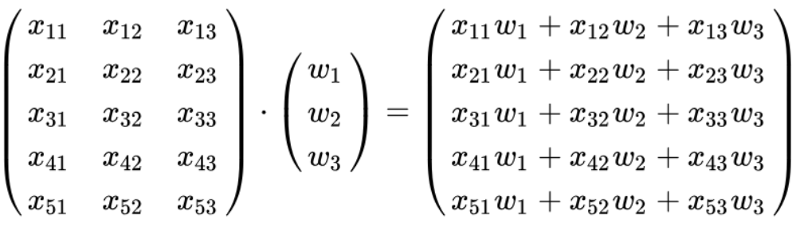
PNP
PASSSION & PIONEER
Deep-Neural
Network
Multi-variable Linear regression
많은 데이터가 있을때 가설(모델) 구성 방법을 보자
X1 | X2 | X3 | Y
96 | 91 | 99 | 194
88 | 85 | 82 | 181
78 | 77 | 73 | 177
67 | 66 | 61 | 164
55 | 51 | 53 | 157

Slide 36
PNP
PASSSION & PIONEER
Deep-Neural
Network
Multi-variable Linear regression
주어진 데이터와 결과
X1 | X2 | X3 | Y
96 | 91 | 99 | 194
88 | 85 | 82 | 181
78 | 77 | 73 | 177
67 | 66 | 61 | 164
55 | 51 | 53 | 157
( 5 x 3)
( 3 x 1)
( 5 x 1)

Slide 37
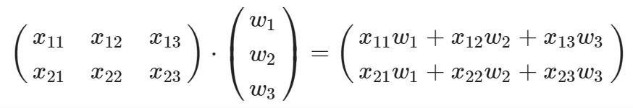
PNP
PASSSION & PIONEER
Deep-Neural
Network
Multi-variable Linear regression
주어진 데이터에 따른 모델 구성
Our model
Our data
model outputs
?

Slide 38
PNP
PASSSION & PIONEER
Deep-Neural
Network
Multi-variable Linear regression
주어진 데이터에 따른 모델 구성
Our model
Our data
model outputs
( 2 x 3)
( 3 x 1)
( 2 x 1)
주어진 데이터 크기에 맞는 가중치를 가지는 모델로 구성

Slide 39
PNP
PASSSION & PIONEER
Deep-Neural
Network
Binary Classification

Slide 40




PNP
PASSSION & PIONEER
Deep-Neural
Network
Binary Classification - Hypothesis
Binary classification을 수행하기 위한 모델 구성
Regression 모델
Classification 모델

Slide 41



PNP
PASSSION & PIONEER
Deep-Neural
Network
Sigmoid Activation
Classification 수행을 위한 layer의 output에 Sigmoid 사용

Slide 42

PNP
PASSSION & PIONEER
Deep-Neural
Network
Loss(Cost) Function
output
정답값의 차이로 Loss function을 정의할 수 없음
새로운 Loss function 적용 필요

Slide 43

PNP
PASSSION & PIONEER
Deep-Neural
Network
Loss(Cost) Function

Slide 44

PNP
PASSSION & PIONEER
Deep-Neural
Network
Loss(Cost) Function

Slide 45

PNP
PASSSION & PIONEER
Deep-Neural
Network
Loss(Cost) Function

Slide 46

PNP
PASSSION & PIONEER
Deep-Neural
Network
Maximum Likelihood

Slide 47

PNP
PASSSION & PIONEER
Deep-Neural
Network
Maximum Likelihood

Slide 48

PNP
PASSSION & PIONEER
Deep-Neural
Network
Maximum Likelihood

Slide 49

PNP
PASSSION & PIONEER
Deep-Neural
Network
Maximum Likelihood

Slide 50



PNP
PASSSION & PIONEER
Deep-Neural
Network
Cross Entropy - 정보량 (Self-Information)
일어나기 힘든 일 일수록 정보가 높다고 가정

Slide 51

PNP
PASSSION & PIONEER
Deep-Neural
Network
Cross Entropy - Entropy

Slide 52

PNP
PASSSION & PIONEER
Deep-Neural
Network
Cross Entropy - Entropy
두 확률 분포의 차이 또는 유사하지 않은 정도(dissimilarity)를 나타냄
추정 확률 q 의 정보량을 확률 p 에 대해 구한 기대값

Slide 53

PNP
PASSSION & PIONEER
Deep-Neural
Network
Cross Entropy - Binary

Slide 54

PNP
PASSSION & PIONEER
Deep-Neural
Network
Binary Classification
모델이 예측한 Bernoulli Distribution으로 Decision Boundary를 찾는다.
각 데이터의 class는 이미 구분되어 있다.
Classification 모델
https://towardsdatascience.com/introduction-to-logistic-regression-66248243c148

Slide 55



PNP
PASSSION & PIONEER
Deep-Neural
Network
Multiclass classification
여러 데이터로부터 Multiclass를 구분할 수 있을까?
?

Slide 56

PNP
PASSSION & PIONEER
Deep-Neural
Network
Multiclass classification
Softmax activation을 이용해 Categorical Distribution을 출력할 수 있다.

Slide 57
PNP
PASSSION & PIONEER
Deep-Neural
Network
Softmax activation

Slide 58


PNP
PASSSION & PIONEER
Deep-Neural
Network
Multiclass classification
0
1
0
...
다람쥐
고양이
강아지
...
label

Slide 59

PNP
PASSSION & PIONEER
Deep-Neural
Network
Feedforward Network

Slide 60

PNP
PASSSION & PIONEER
Deep-Neural
Network
Feedforward Network
input layer
데이터를 입력받는 layer
노드당 1차원 벡터로 입력
hidden layers
hidden layers의 크기로 Network size가 결정 됨
output layer
원하는 형태로 데이터 출력
http://neuralnetworksanddeeplearning.com/chap2.html

Slide 61

PNP
PASSSION & PIONEER
Deep-Neural
Network
Feedforward Network
: vectors
http://neuralnetworksanddeeplearning.com/chap2.html

Slide 62

PNP
PASSSION & PIONEER
Deep-Neural
Network
Feedforward Network
: vectors
http://neuralnetworksanddeeplearning.com/chap2.html

Slide 63

PNP
PASSSION & PIONEER
Deep-Neural
Network
Feedforward Network
: vectors
http://neuralnetworksanddeeplearning.com/chap2.html

Slide 64

PNP
PASSSION & PIONEER
Deep-Neural
Network
Feedforward Network
: vectors
http://neuralnetworksanddeeplearning.com/chap2.html

Slide 65




PNP
PASSSION & PIONEER
Deep-Neural
Network
Feedforward Network
: vector
: matrix
: vector
http://neuralnetworksanddeeplearning.com/chap2.html

Slide 66
PNP
PASSSION & PIONEER
Deep-Neural
Network
Feedforward Network
http://neuralnetworksanddeeplearning.com/chap2.html

Slide 67


PNP
PASSSION & PIONEER
Deep-Neural
Network
Feedforward Network
activation function:
sigmoid function
http://neuralnetworksanddeeplearning.com/chap2.html

Slide 68
02
Activation Function

Slide 69

PNP
PASSSION & PIONEER
Activation
Function
Activation Function

Slide 70

PNP
PASSSION & PIONEER
Activation
Function
Step Function

Slide 71

PNP
PASSSION & PIONEER
Activation
Function
Sigmoid

Slide 72

PNP
PASSSION & PIONEER
Activation
Function
Sigmoid

Slide 73


PNP
PASSSION & PIONEER
Activation
Function
Zero-centered

Slide 74

PNP
PASSSION & PIONEER
Activation
Function
Hyperbolic Tangent

Slide 75

PNP
PASSSION & PIONEER
Activation
Function
Hyperbolic Tangent
Tanh 함수의 미분

Slide 76

PNP
PASSSION & PIONEER
Activation
Function
Rectified Linear Unit

Slide 77

PNP
PASSSION & PIONEER
Activation
Function
Dead ReLU

Slide 78

PNP
PASSSION & PIONEER
Activation
Function
Leaky ReLU

Slide 79

PNP
PASSSION & PIONEER
Activation
Function
ELU (Exponential Linear)

Slide 80

PNP
PASSSION & PIONEER
Activation
Function
MaxOut

Slide 81


PNP
PASSSION & PIONEER
Activation
Function
MaxOut
임의의 Convex 함수를 근사
비교할 파라미터가 많아져 연산량 증가로 잘 사용하지 않는다.

Slide 82
PNP
PASSSION & PIONEER
Activation
Function
Summary
가장 먼저 ReLU를 사용하자.
Leaky ReLU, ELU, Maxout 등이 있지만, 가장 많이 사용되는 activation 함수는 ReLU이다.
tanh도 사용할 순 있지만 큰 기대는 하지 않는게 좋다.
sigmoid는 사용을 자제하자

Slide 83
03
Backpropagation

Slide 84

PNP
PASSSION & PIONEER
Back
propagation
Backpropagation

Slide 85

PNP
PASSSION & PIONEER
Back
propagation
Backpropagation

Slide 86

PNP
PASSSION & PIONEER
Back
propagation
Backpropagation
Weight update

Slide 87

PNP
PASSSION & PIONEER
Back
propagation
Backpropagation
Weight update
Label값과 모델 예측값으로 Loss 계산 후 전파

Slide 88

PNP
PASSSION & PIONEER
Back
propagation
합성 함수 미분

Slide 89

PNP
PASSSION & PIONEER
Back
propagation
Backpropagation

Slide 90

PNP
PASSSION & PIONEER
Back
propagation
Backpropagation

Slide 91

PNP
PASSSION & PIONEER
Back
propagation
Backpropagation

Slide 92

PNP
PASSSION & PIONEER
Back
propagation
Backpropagation
http://mac.kaist.ac.kr/~juhan/gct634/slides/06-deep_learning_intro.pdf

Slide 93

PNP
PASSSION & PIONEER
Back
propagation
Backpropagation
http://mac.kaist.ac.kr/~juhan/gct634/slides/06-deep_learning_intro.pdf

Slide 94


PNP
PASSSION & PIONEER
Back
propagation
Backpropagation
http://mac.kaist.ac.kr/~juhan/gct634/slides/06-deep_learning_intro.pdf

Slide 95

PNP
PASSSION & PIONEER
Back
propagation
Backpropagation
http://mac.kaist.ac.kr/~juhan/gct634/slides/06-deep_learning_intro.pdf

Slide 96



PNP
PASSSION & PIONEER
Back
propagation
Backpropagation
http://mac.kaist.ac.kr/~juhan/gct634/slides/06-deep_learning_intro.pdf

Slide 97

PNP
PASSSION & PIONEER
Back
propagation
Backpropagation
http://mac.kaist.ac.kr/~juhan/gct634/slides/06-deep_learning_intro.pdf

Slide 98
PNP
PASSSION & PIONEER
Back
propagation
Backpropagation
http://mac.kaist.ac.kr/~juhan/gct634/slides/06-deep_learning_intro.pdf

Slide 99




PNP
PASSSION & PIONEER
Back
propagation
Backpropagation
http://mac.kaist.ac.kr/~juhan/gct634/slides/06-deep_learning_intro.pdf

Slide 100


PNP
PASSSION & PIONEER
Back
propagation
Backpropagation
http://mac.kaist.ac.kr/~juhan/gct634/slides/06-deep_learning_intro.pdf

Slide 101

PNP
PASSSION & PIONEER
Back
propagation
Backpropagation
http://mac.kaist.ac.kr/~juhan/gct634/slides/06-deep_learning_intro.pdf

Slide 102




PNP
PASSSION & PIONEER
Back
propagation
Backpropagation
http://mac.kaist.ac.kr/~juhan/gct634/slides/06-deep_learning_intro.pdf

Slide 103

PNP
PASSSION & PIONEER
Back
propagation
Backpropagation
http://mac.kaist.ac.kr/~juhan/gct634/slides/06-deep_learning_intro.pdf

Slide 104

PNP
PASSSION & PIONEER
Back
propagation
Network size

Slide 105

PNP
PASSSION & PIONEER
Back
propagation
Network size
Goodfellow, Ian, Yoshua Bengio, and Aaron Courville. Deep learning. MIT press, 2016.

Slide 106
PNP
Q & A ?

